Slide 1

WIPRO NGA Program – SDET(Selenium)_25VID0810
Capstone Project Presentation –13th and 14th June
Project Titles Here -
Amazon_Automation
Vschool_Rest_Assured_API_Testing
Presented by –Varun Vishwakarma
www.rpsconsulting.in

Slide 2

Table of contents
Project Overview
Tools and Technology
Project Design
BDD Cucumber with Page Object Mode
Rest Assured API Testing Using BDD
GitHub
Jenkins
Conclusion
2025 - RPS Consulting all rights reserved

Slide 3
ProjectOverview
Amazon_Automation
This project automates testing for the Amazon.com website using Selenium WebDriver. Utilizes BDD with Cucumber and POM for scalable, maintainable test code. Integrates Maven for dependency management and TestNG for execution. Supports CI/CD via Jenkins and source control via GitHub.
Vschool_REST_Assured_API_Testing
The main objective of this project is to automate API testing for the VSchool application using REST Assured with Java. The goal is to validate the behavior of various endpoints (like user registration, login, course management, etc.) to ensure the backend APIs are reliable, performant, and meet functional requirements.
2025 - RPS Consulting all rights reserved

Slide 4

Amazon.com
2025 - RPS Consulting all rights reserved

Slide 5
Tools and Technologies
Eclipse IDE
Maven
JAVA
Selenium WebDriver
BDD Cucumber
Page Object Model
Rest Assured
Postman
Extent Report
Html Cucumber Report
GitHub
Jenkins
2025 - RPS Consulting all rights reserved

Slide 6
Project Design
Behavior-Driven Development approach (BDD)
Page Object Model (POM)
Data-Driven approach
REST Assured
GitHub
Jenkin
2025 - RPS Consulting all rights reserved

Slide 7
BDD Cucumber with Page Object Mode
What is BDD (Behavior Driven Development)?
A collaborative approach where testers, developers, and business analysts define test cases in plain English.
Focuses on "What the system should do".
Written using Gherkin syntax (Given-When-Then format)
What is Cucumber?
A BDD testing tool used to write automated acceptance tests.
Uses Gherkin language to write feature files (.feature)
Integrates with Java, Selenium, and REST Assured for test execution.
What is Page Object Model (POM)?
A design pattern to create Object Repositories for web elements.
Improves code readability, reusability, and maintainability.
Each page in the application has a corresponding Java class.
2025 - RPS Consulting all rights reserved

Slide 8
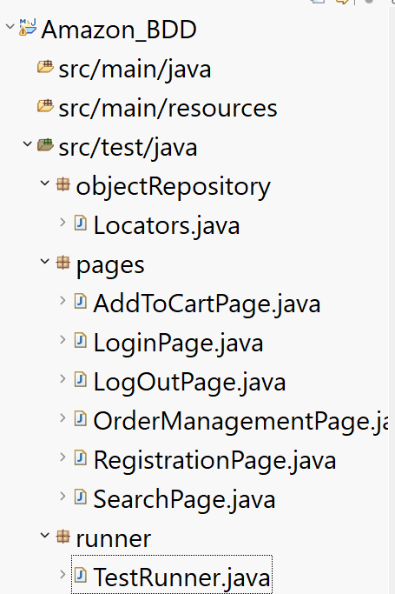
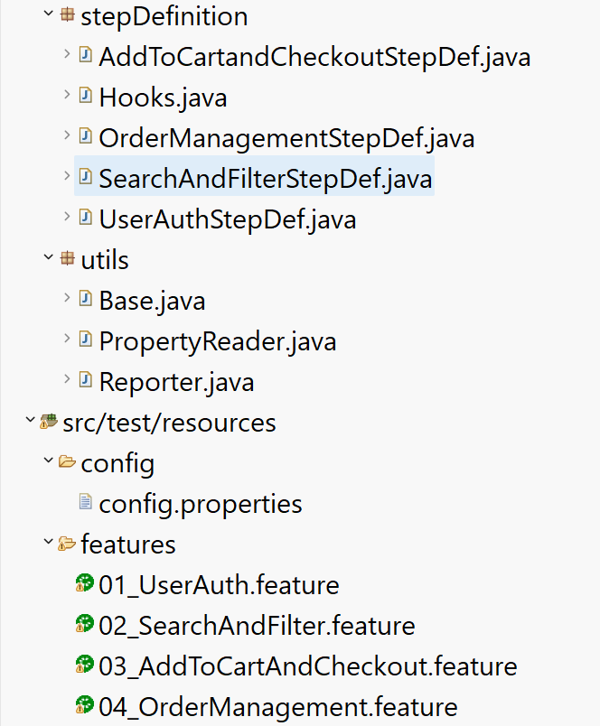
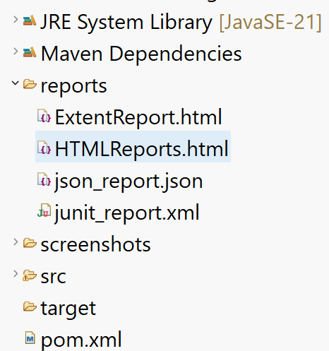
Project Structure of Amazon_BDD

Slide 9
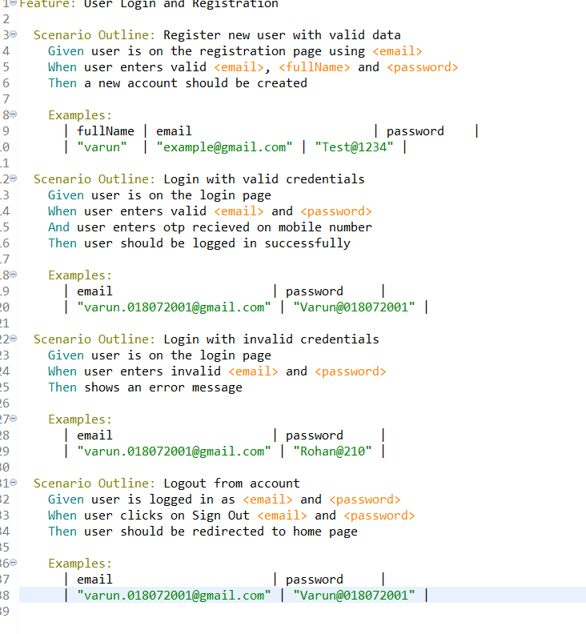
Screenshot of 01_UserAuth.feature
2025 - RPS Consulting all rights reserved

Slide 10
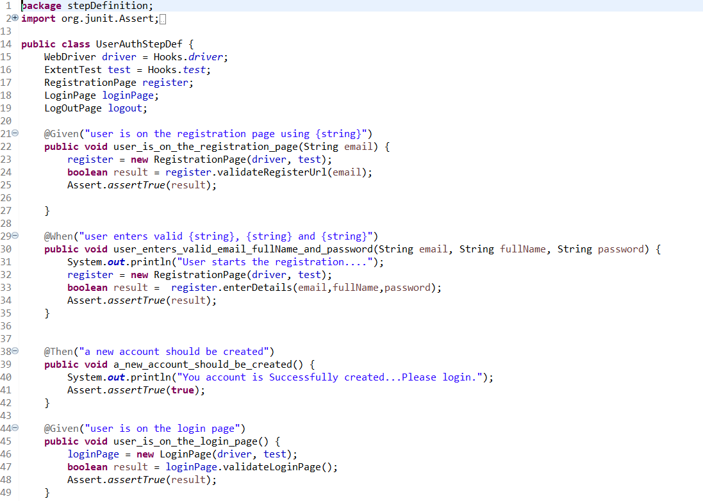
Screenshot of UserAuthStepDef.java
2025 - RPS Consulting all rights reserved

Slide 11
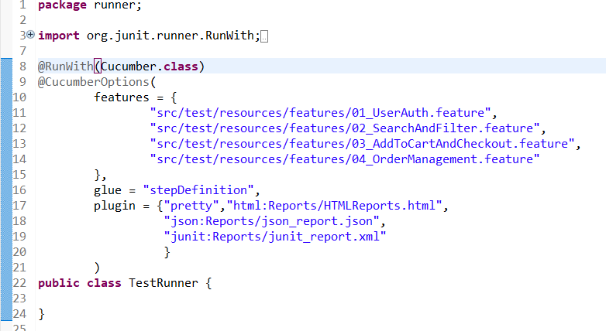
Screenshot of Test Runner File
2025 - RPS Consulting all rights reserved

Slide 12
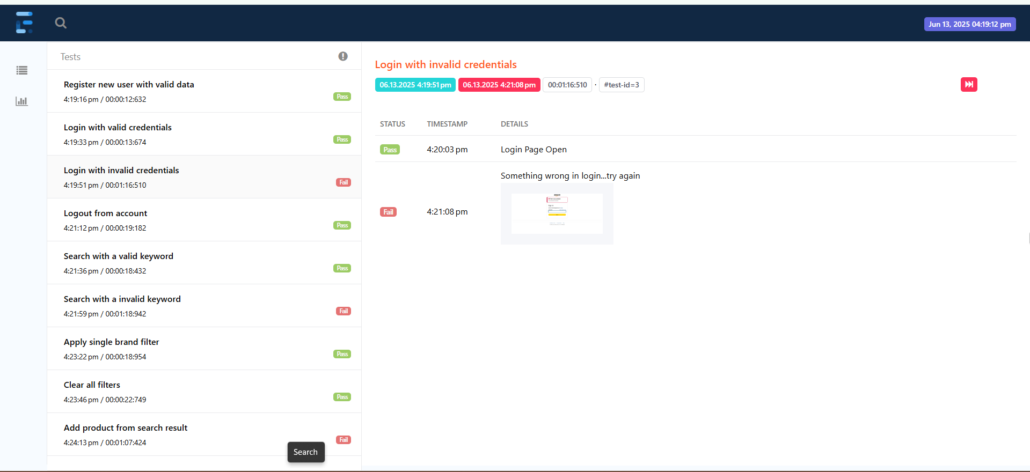
Screenshot of Extent Report
2025 - RPS Consulting all rights reserved

Slide 13
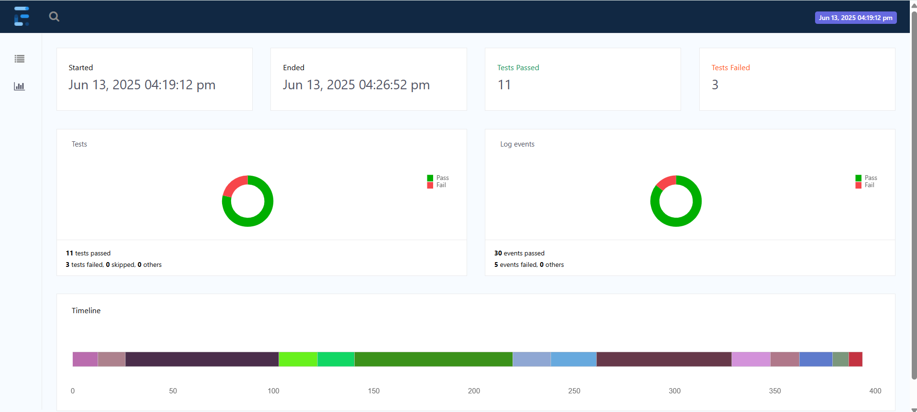
Screenshot of Extent Report
2025 - RPS Consulting all rights reserved

Slide 14
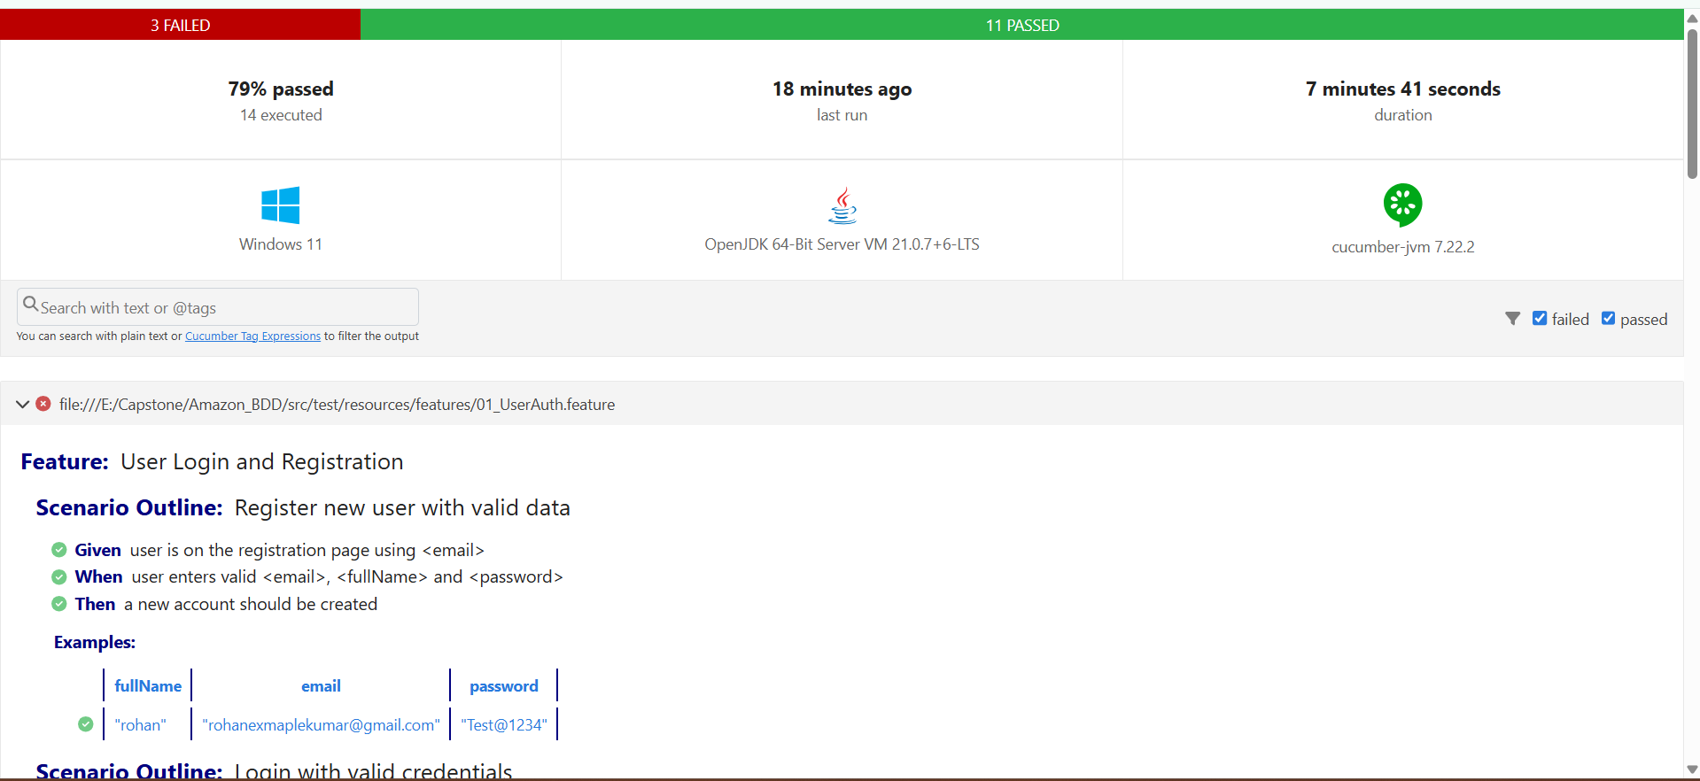
Screenshot of Cucumber Report
2025 - RPS Consulting all rights reserved

Slide 15
Vschool_API_Rest_Assured
API Link -> https://api.vschool.io/%5byour_name%5d/todo/
2025 - RPS Consulting all rights reserved

Slide 16
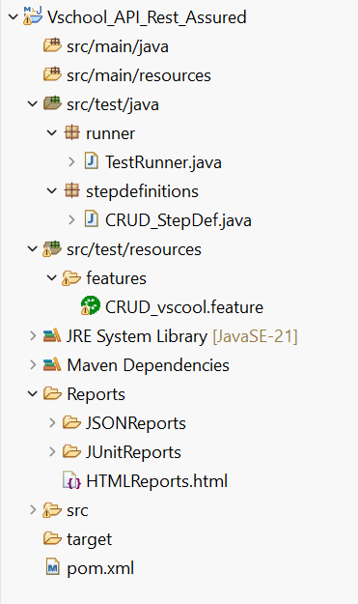
Project Structure of Vschool_API_Testing

Slide 17
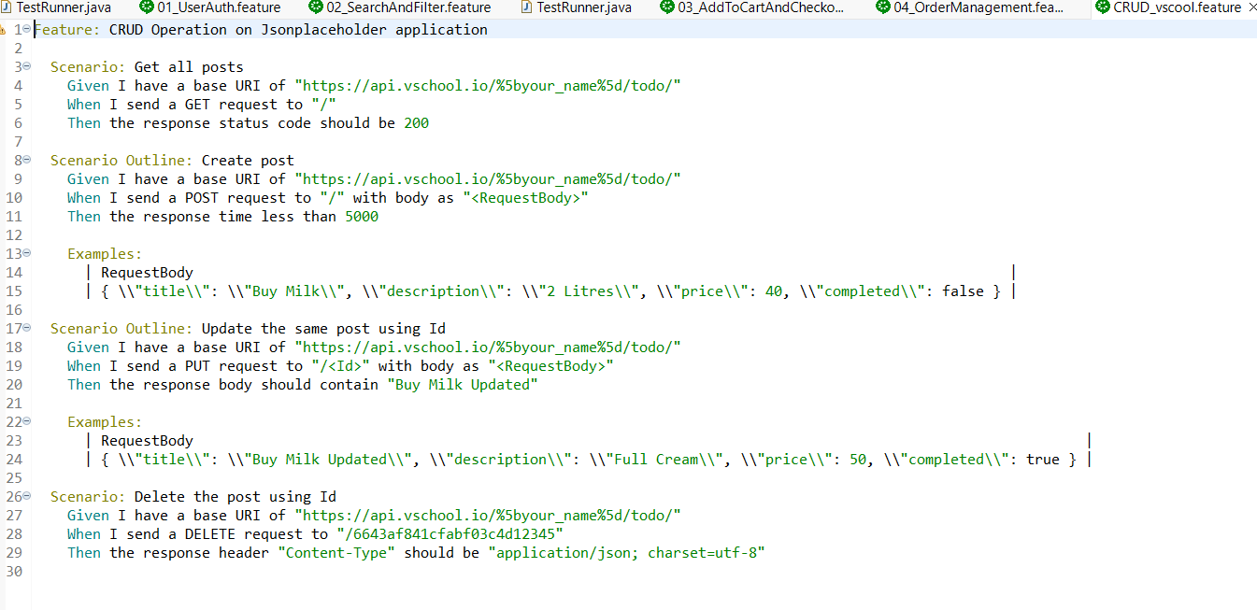
Screenshot of feature file
2025 - RPS Consulting all rights reserved

Slide 18
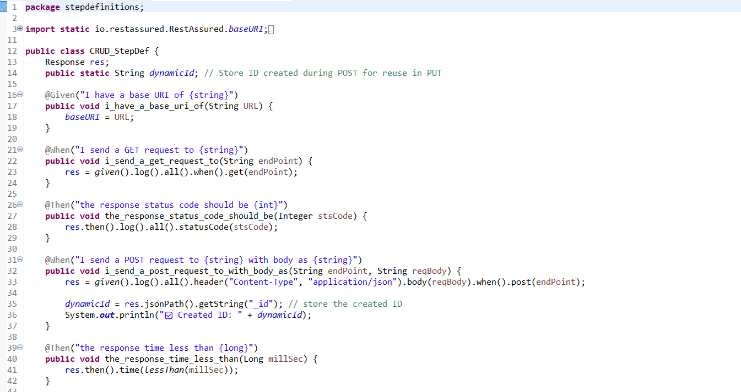
Screenshot of step definition
2025 - RPS Consulting all rights reserved

Slide 19
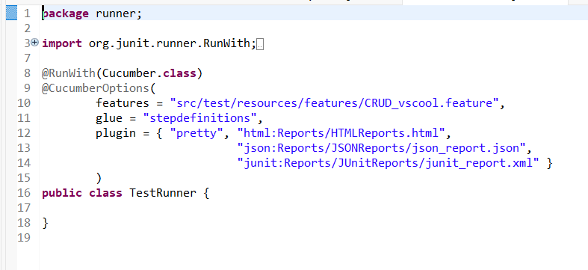
Screenshot of Test Runner File
2025 - RPS Consulting all rights reserved

Slide 20
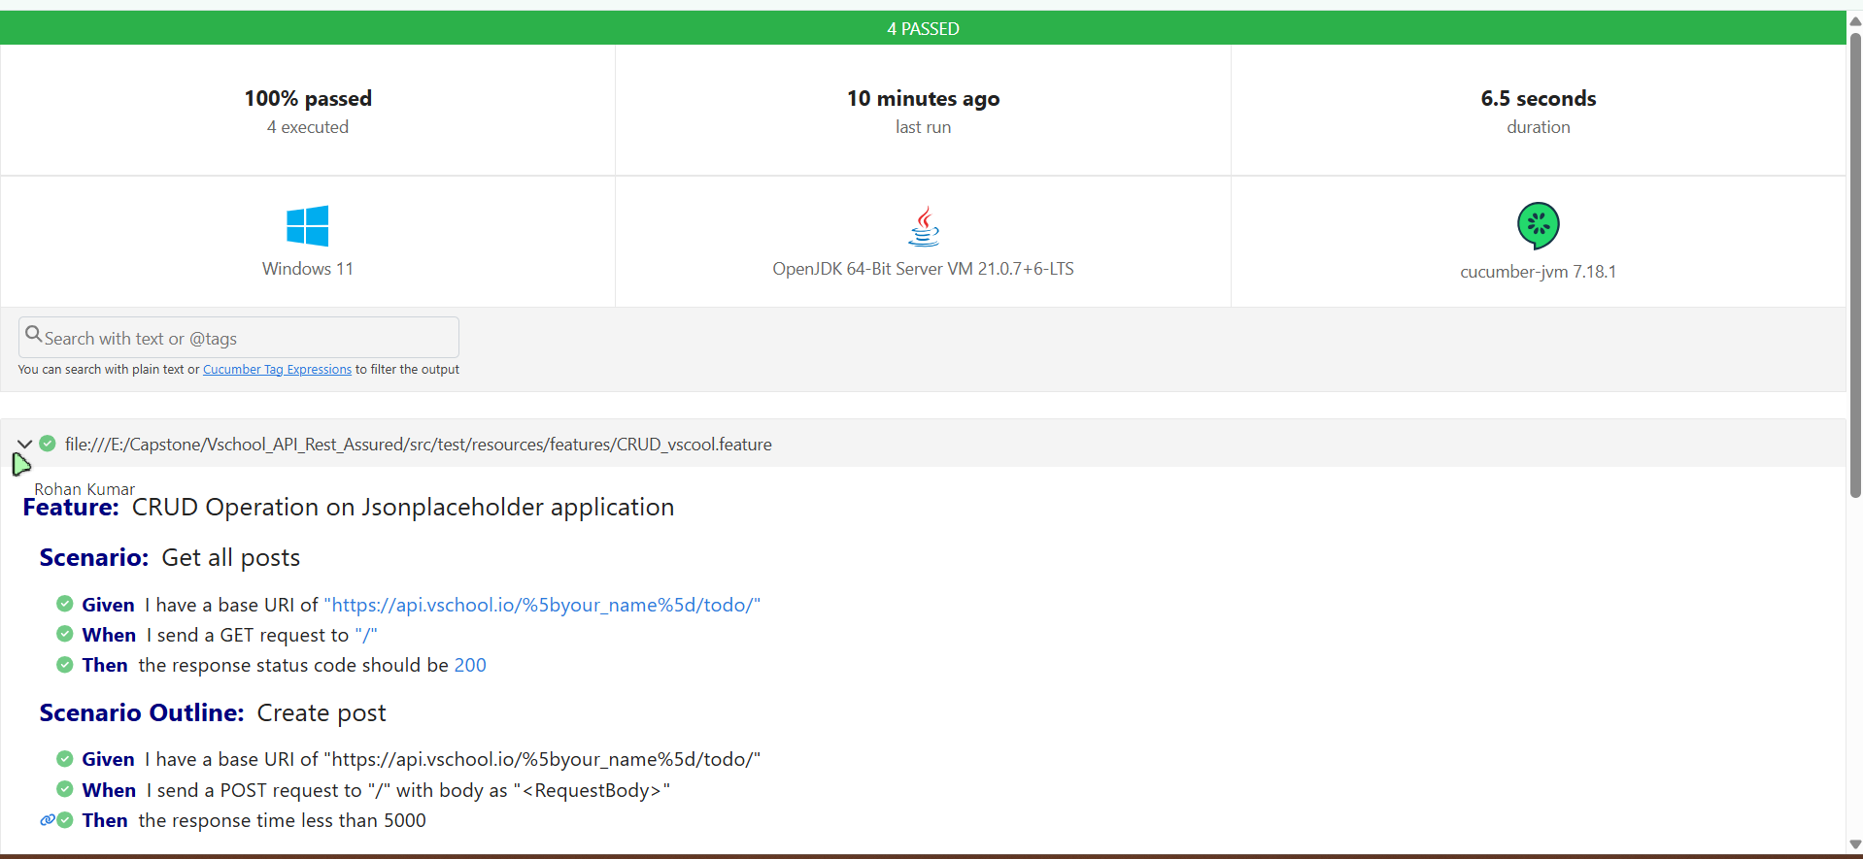
Screenshot of Cucumber Report
2025 - RPS Consulting all rights reserved

Slide 21
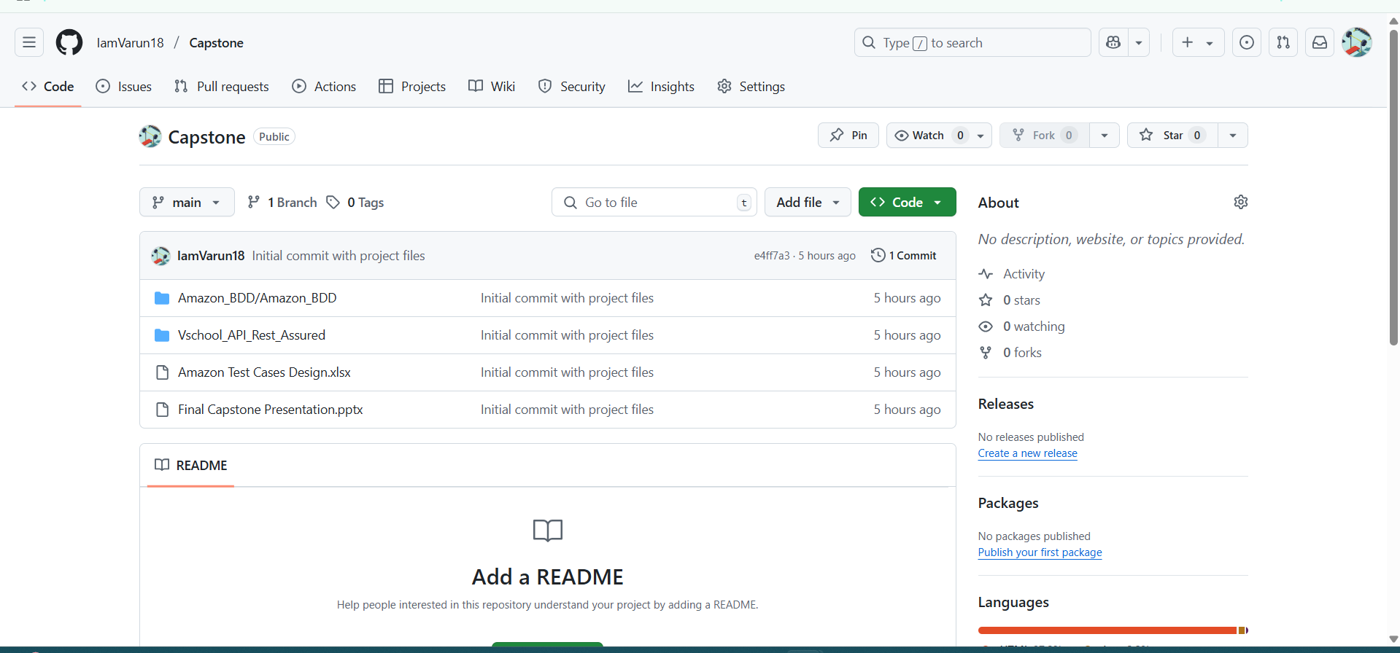
GitHub Screenshot

Slide 22
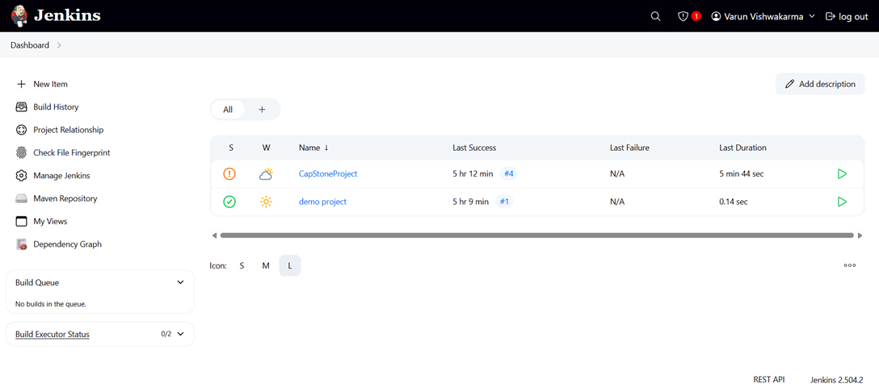
Jenkins Screenshot
2025 - RPS Consulting all rights reserved

Slide 23
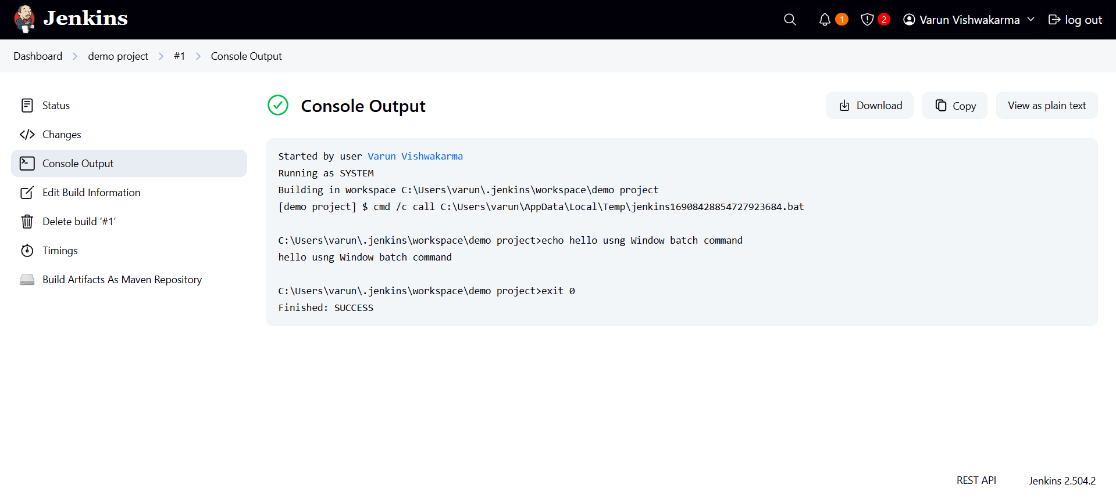
Jenkins Results Screenshot
2025 - RPS Consulting all rights reserved

Slide 24
Conclusion
Amazon_Automation
This Amazon.com automation testing project focused on validating essential user workflows like login, search, cart management, and order tracking using Selenium WebDriver. By combining Cucumber for BDD and the Page Object Model (POM) design, we achieved readable, scalable, and maintainable test scripts.
TestNG supported structured execution and reporting, while Maven handled dependencies efficiently. Jenkins integration enabled continuous testing, making our framework CI/CD-ready. Reports from Allure and Extent provided valuable insights into test outcomes, including screenshots for failures.
Overall, the project demonstrated a complete end-to-end test automation pipeline with modern tools and best practices—delivering reliability, efficiency, and real-world readiness.
Vschool_REST_Assured_API_Testing
In conclusion, the REST Assured API Testing project for the Vschool application has successfully automated the validation of various RESTful services. By implementing comprehensive test cases for multiple endpoints—such as students, teachers, and courses—the project ensured API functionality, correctness, and robustness. Using tools like REST Assured, TestNG, and Maven streamlined the test development and execution process. This automation framework not only improved test efficiency and accuracy but also laid a strong foundation for integrating API testing into continuous integration pipelines. Overall, the project contributes significantly to delivering a reliable and quality-assured backend service.
2025 - RPS Consulting all rights reserved

